Slide 1

Linear Temporal Difference
Notes:
1

Slide 2
Objectives
Understand that tabular TD is a special case of linear semi-gradient TD
Understand the fixed point of linear TD learning
Linear Temporal Difference
2
Notes:
2

Slide 3
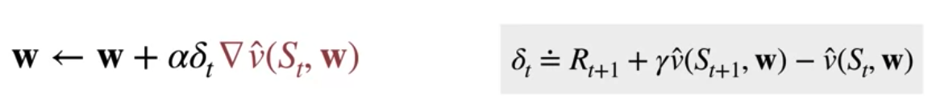
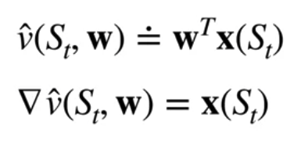
Temporal Difference Update
TD update with linear function approximation
Semi gradient TD adjusts the weights and the direction of the TD air times the gradient of the approximate value function with respect to the weights.
In the linear case, the gradient of the approximate value for a state is just the feature vector for that state
Linear Temporal Difference
3
Notes:
3

Slide 4
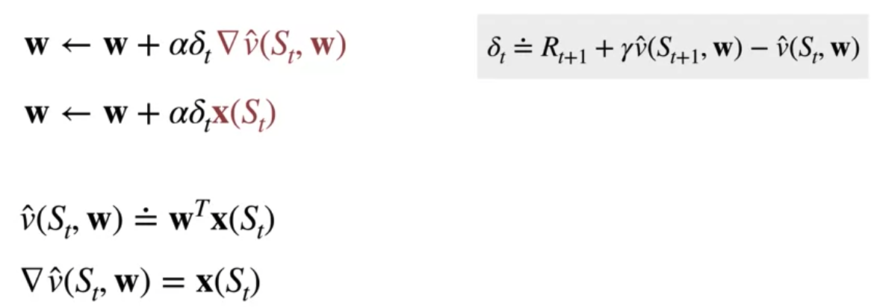
Temporal Difference Update
The update for semi gradient TD would look like:
The weight is updated in the direction of the feature vector times the TD air.
If a feature is large, then the corresponding weight can have a large impact on the prediction.
If the feature is zero, then that weight has no impact on the prediction and the gradient is therefore zero.
Linear Temporal Difference
4
Notes:
4

Slide 5
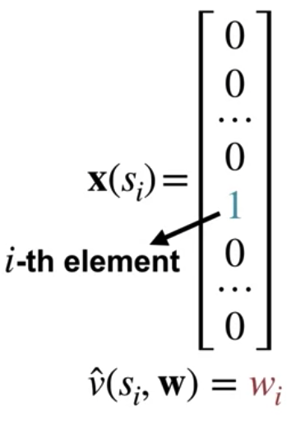
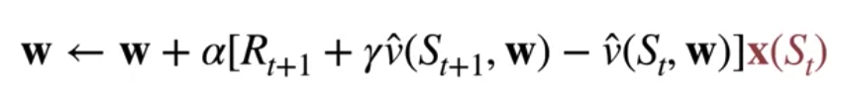
Temporal Difference Update
Tabular TD is a special case of liner TD
We have a tabular state representation( Only one feature will be equal to one corresponding to the current state)
The value approximation for a state is equal to the weight associated with the current state
The update for semi gradient TD with these tabular features
Linear Temporal Difference
5
Notes:
5

Slide 6
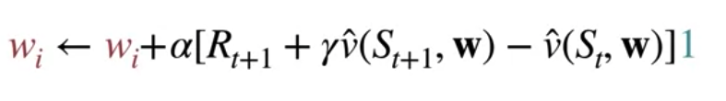
Temporal Difference Update
Tabular TD is a special case of liner TD
In the update, the feature vector X of ST selects a single weight associated with the current state.
This weight is just the value estimate for the state. So this update corresponds to the tabular TD update we saw in a previous course.
We can use the same analysis to show that TD with state aggregation is also a special case of linear TD
Linear Temporal Difference
6
Notes:
6

Slide 7
The Expected TD Update
The TD update with linear function approximation
The value of a state is the inner product of the state features and the learn weight vector.
X_ t to mean the features associated with the state S_t.
Linear Temporal Difference
7
Notes:
7

Slide 8
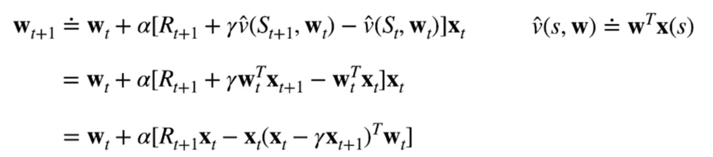
The Expected TD Update
The TD update with linear function approximation
We can rewrite this using a bit of linear algebra.
We'll pull X_t into the brackets.
We then use the fact that taking the transpose of a scalar, leaves it unchanged.
Linear Temporal Difference
8
Notes:
8

Slide 9
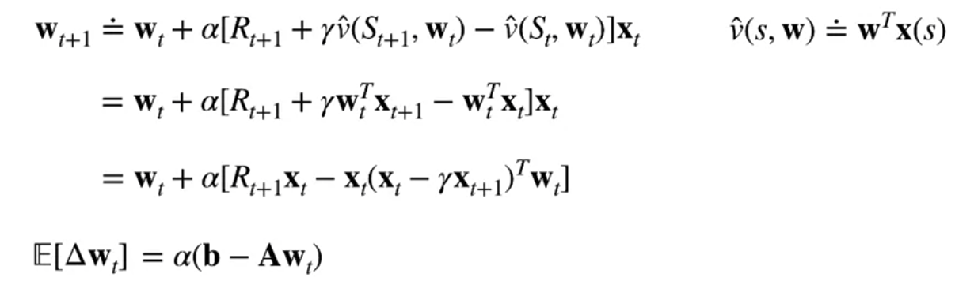
The Expected TD Update
The TD update with linear function approximation
The TD update can be rewritten as the expected update plus a noise term, and so is largely dominated by the behavior of the expected update.
The expected update characterizes the expected change in the weight from one time step to the next.
The expected TD update can be written as a vector b minus a matrix A times the current weight.
Linear Temporal Difference
9
Notes:
9

Slide 10
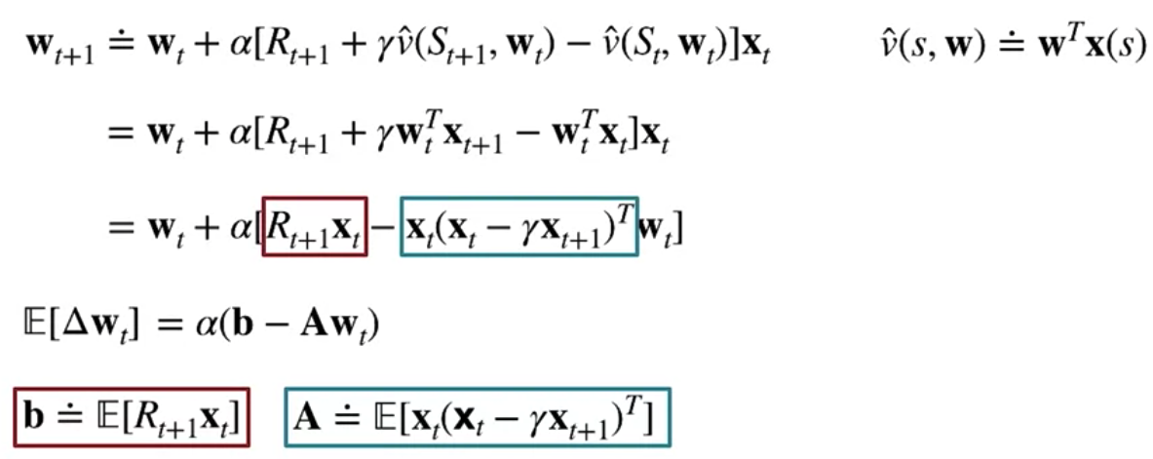
The Expected TD Update
The TD update with linear function approximation
The matrix A is defined in terms of an expectation over the features, while the vector b is defined in terms of the features and the reward.
Linear Temporal Difference
10
Notes:
10

Slide 11
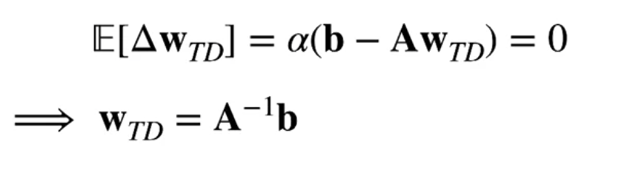
The Expected TD Update
The TD Fixed point:
The weights are said to converge, when this expected TD update is zero.
We call this point W_TD.
If A is invertible, we can express this as W_TD equals A inverse b.
More generally, W_TD is a solution to this linear system.
Linear Temporal Difference
11
Notes:
11

Slide 12
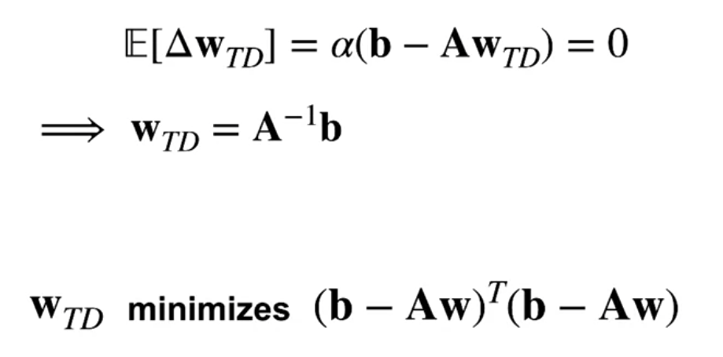
The Expected TD Update
The TD Fixed point:
It can be shown that TD minimizes an objective that is based on this A and b.
This objective extends the connection between TD and Bellman equations, to the function approximation setting.
Linear Temporal Difference
12
Notes:
12

Slide 13
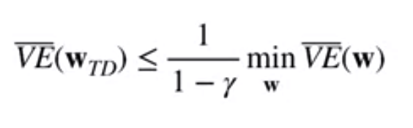
TD Fixed Poin
The relating the TD Fixed Point and the Minimum of the Value Error
The difference between the TD fixed point and the minimum value error solution can be large if Gamma is close to one.
If Gamma is very close to zero on the other hand, the TD fixed point is very close to the minimum value error solution.
Linear Temporal Difference
13
Notes:
13

Slide 14
Summary
Understand that tabular TD is a special case of linear semi-gradient TD
Understand the fixed point of linear TD learning
Linear Temporal Difference
14

Slide 15
Q & A
Linear Temporal Difference
15

